Slide 1


Sapient Holiday Calendar mini-app
Vision Statement
  A Sapient Holiday Calendar will allow Sapient people to view public and floating holidays by region or country. Users will also be able to insert individual or team vacation days.
Problem
  When planning for a distributed team, accessing country holiday schedules is cumbersome. When developing integrated project plans that show individual vacations as well as team holidays, teams frequently reinvent the wheel (and waste effort in the process)
  Key holidays are often overlooked when scheduling meetings
Solution
  Add a company wide holiday calendar on the Sapient People Portal using .Net and HTML

Slide 2
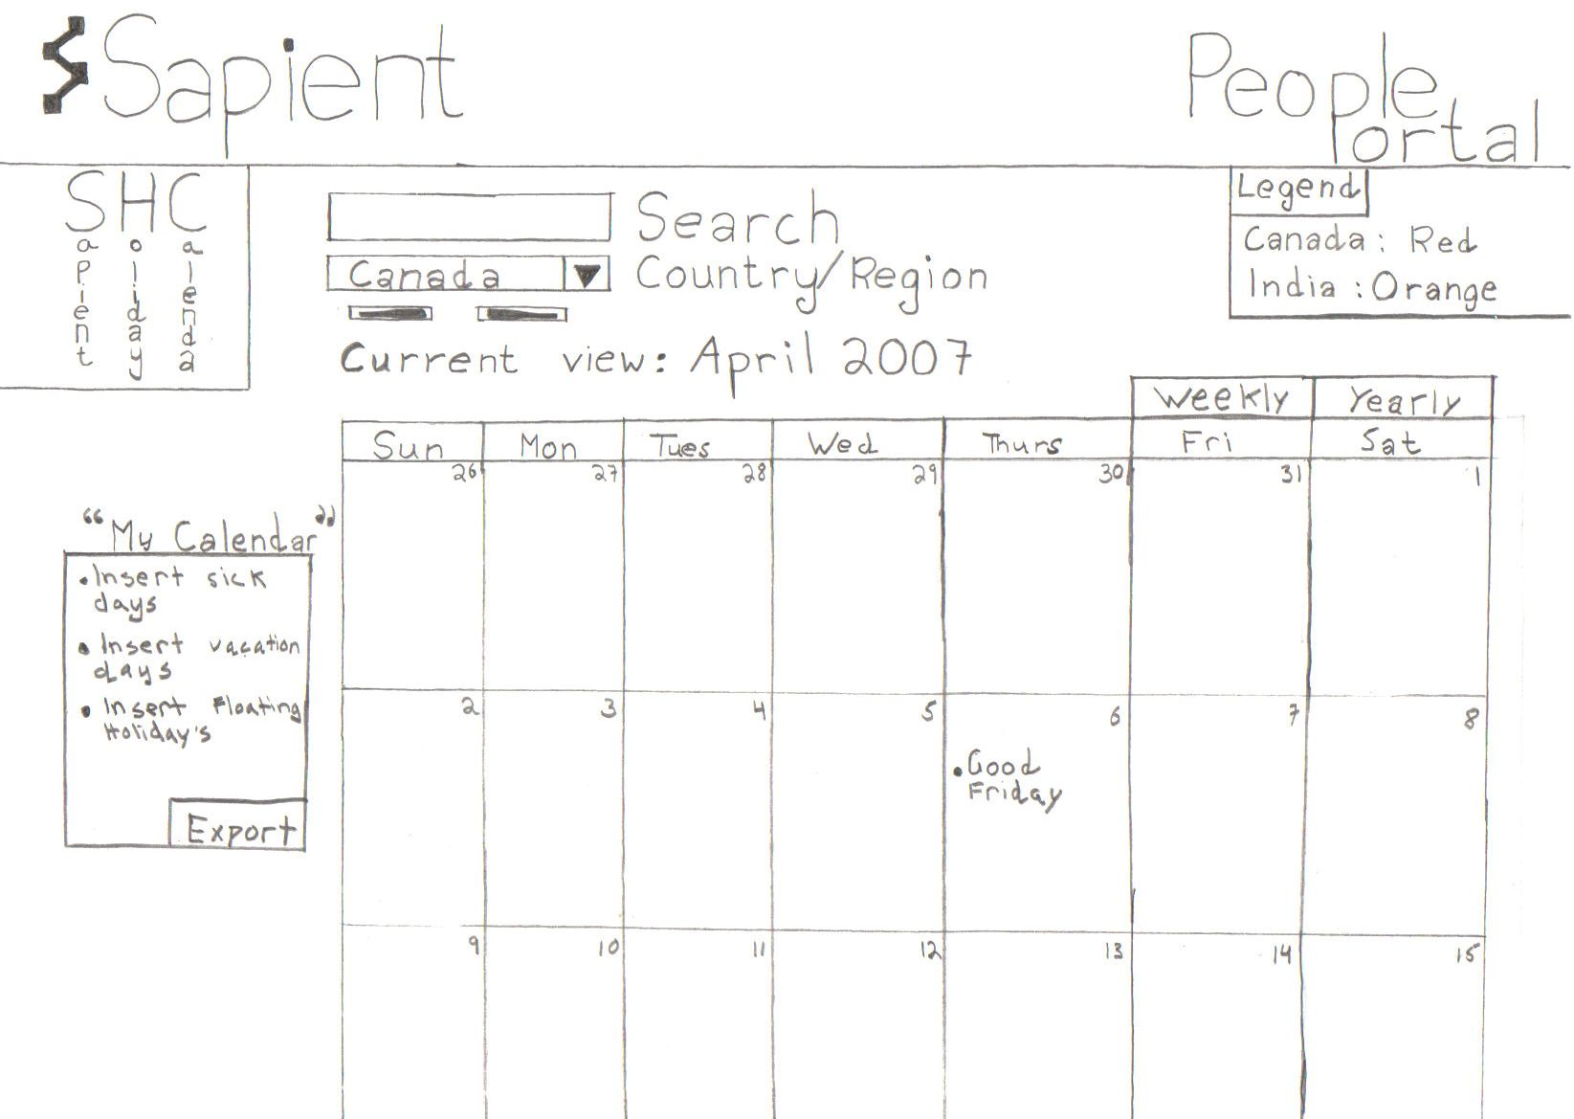
Sketch

